Slide 1
machine learning to anlyze birds affected by mobile towers

Slide 2
Group Member Information:
Nikitha Bukka – 700746938
Sharanya Amudala – 700747008
Sri Ram Kandagatla – 700745188
Arun Kalagoni - 700747118

Slide 3
Role/Responsibilities and Contribution in project:
Sriram: Responsible for gathering data, evaluating it, and identifying behavioral patterns to investigate the effects of mobile towers on birds.
Nikitha: Responsible for creating logistic regression machine learning model to forecast how mobile towers would affect birds based on the information gathered and prepared.
Sharanya: Responsible for comparing the above predicted model with other available regression model(Linear regression).
Arun: Responsible for developing visualizations of the output produced by the previously mentioned machine learning models and presenting conclusions to the team. writing a report on the research's conclusions and include suggestions for reducing the negative effects of cell towers on birds

Slide 4
Motivation:
This project's primary goal is to look into how mobile towers affect birds and their habitats. We can better understand how mobile towers are affecting the ecosystem by gathering information on bird numbers and the locations of these towers. Python will be used to examine the data and produce visuals. This initiative will enable us to better understand how mobile towers affect birds and their habitats, enabling us to plan the future location of these towers.
Machine learning will be used to analyze the birds affected by mobile towers, and the reasons why the birds are affected by the tower frequency will be identified. It helps the biology to save the birds and their species for their lifetime.
In this work, different methods and techniques to achieve higher precision for the birds affected by mobile tower prediction are analyzed.

Slide 5
Objectives:
The objective of machine learning to analyze the birds affected by mobile towers is based on the analysis of different attributes. The pre-processing will be applied to the dataset, and the noisy and null-valued data will be removed from the dataset.
Search for any correlations in the data on how mobile towers affect birds and better understand how mobile towers affect birds by building visualizations using the data gathered.
The machine learning algorithm will be chosen to make the prediction.

Slide 6
Related Work:
A Systematic Review of the Impacts of Mobile Phone Towers on Bird Diversity and Abundance: In this study, the impact of mobile phone towers on bird diversity and abundance in various environments is investigated. It investigates how these towers affect avian diversity, abundance, and community structure.
An Ecological Perspective on Bird Impacts from Mobile Phone Towers: From an ecological standpoint, this study examines how mobile phone towers affect bird populations.
Effects of Mobile Phone Towers on Bird Populations: This study examines how mobile phone towers affect bird populations. It examines how the existence of such towers impacts the number of birds, the variety of species, and the make-up of bird communities.
Effects of Cell Phone Radiation on Bird Behavior: This review examines how cell phone radiation affects bird behavior. It looks at the impact such radiation has on bird migration.

Slide 7
Problem Statement
The increase in mobile towers in the geo locations around the world increase the signal frequency of the towers.
The mobile tower frequencies are getting vary based on the operators and also the generations like 3G,4G,5G.
Its very difficult to find types of causes these towers will make on different type of birds.
The manual prediction of the towers issues which affects the birds life is very difficult and also very complex in reality.

Slide 8
Proposed Solution:
The dataset of different type of birds affected with different type of mobile towers with frequency range are analyzed.
The machine learning algorithm will provide a way to analyze, how much percenatge of birds has been affected by the mobile tower signal strength. The logistic regression will be applied in this work to predict the birds will get affected in the future based on the current dataset.
The birds affected dataset is given as input to the application and the 70% of dataset is given to training and 30% of data is taken to the testing part. Based on the algorithm execution the future prediction of birds harmfulness in the future part can be easily identified.

Slide 9


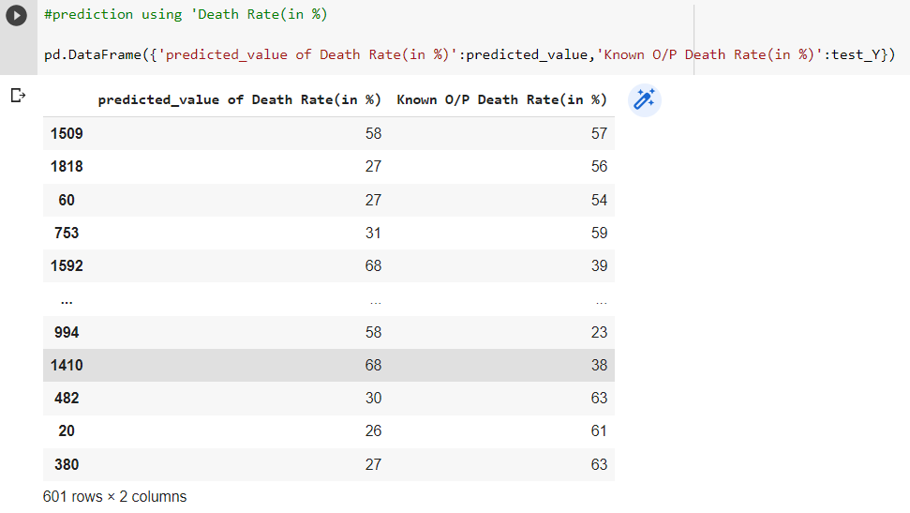
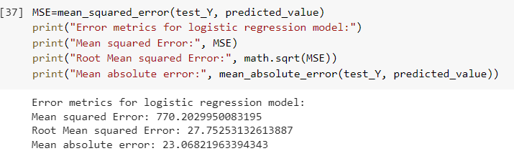
Results/Simulations:
Results of Logistic Regression Model

Slide 10
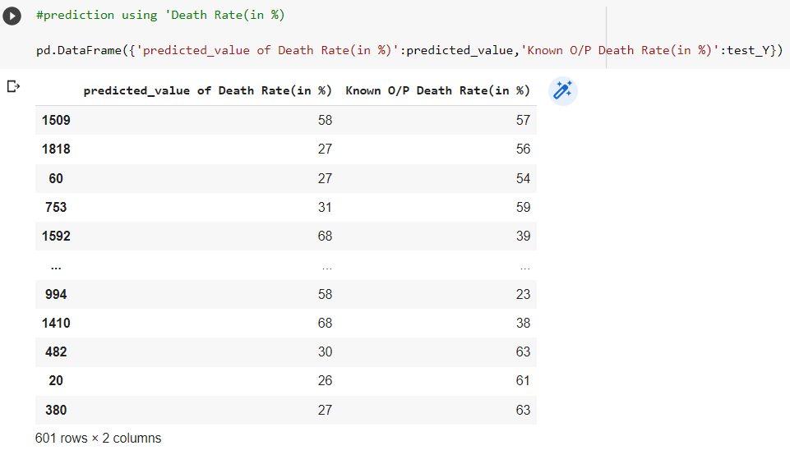
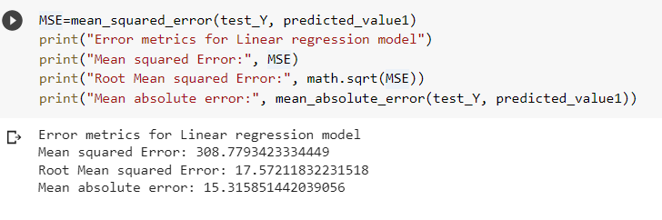
Results/Simulations:
Results of Linear Regression Model

Slide 11
References:
[1]. Daniel ben moshe 1, hagit messer 1, (life fellow, ieee), ran nathan2, and nir sapir,” Empirical Study on the Effect of Birds on Commercial Microwave Link”. Volume 10, 2022 from IEEE.
[2]. Sayed, Ahmed N.; Riad, Michael M.Y.R.; Ramahi, Omar M.; Shaker, George (2022, “UUAV Classification using Neural Networks and CAD-generated AV Classification using Neural Networks and CAD-generated Radar Datasets”. UAV Classification using Neural Networks and CAD-generated Radar Datasets. TechRxiv. Preprint.
https://doi.org/10.36227/techrxiv.20085920.v1
[3] al-saman, Ahmed & Cheffena, Michael & Mohamed, Marshed & Bin Azmi, Marwan & Ai, Yun, “Statistical Analysis of Rain at Millimeter Waves in Tropical Area,” IEEE Access. PP. 1-1. 10.1109/ACCESS.2020.2979683.
[4] J. Fl´orez, J. Ortega, A. Betancourt, A. Garc´ıa, M. Bedoya, and J. S. Botero A review of algorithms, methods, and techniques for detecting uavs and uas using audio, radiofrequency, and video applications TecnoL´ogicas, vol. 23, pp. 269–285, 5 2020.
[5] K. B. Kang, J. H. Choi, B. L. Cho, J. S. Lee, and K. T. Kim Analysis of micro-doppler signatures of small uavs based on doppler spectrum IEEE Transactions on Aerospace and Electronic Systems, vol. 57, pp. 3252–3267, 10 2021.
[6] H. Sun, B. S. Oh, X. Guo, and Z. Lin Improving the doppler resolution of ground-based surveillance radar for drone detection IEEE Transactions on Aerospace and Electronic Systems, vol. 55, pp. 3667–3673, 12 2019.

Slide 12
Thank you

